Slide 1
Numerical Analysis (0/7) Motivation & course plan
University of Luxembourg – 2024
Master in Mathematics
Hadrien Beriot
Restricted

Slide 2
Outline
0.1 Introduction: motivations
0.2 Examples
0.3 Goal of the course & working plan
0.4 Plan of the lectures

Slide 3

About me
R&D Manager at Siemens Industry Software NV. (Leuven)
Engineering degree in France (2004)
PhD in Mechanical engineering (2008)
Joined Belgian company to work as a developer (2008)
Researcher in structural dynamics and acoustics (2013)
Team leader in Dynamics and acoustics research (2018)
R&D Manager for Mechanical applications (2023)
Notes:
I liked academia – but I felt like I honestly did not have

Slide 4

0.1 Introduction: motivation

Slide 5
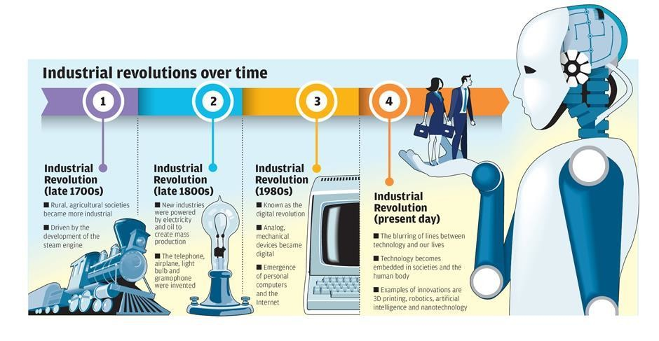
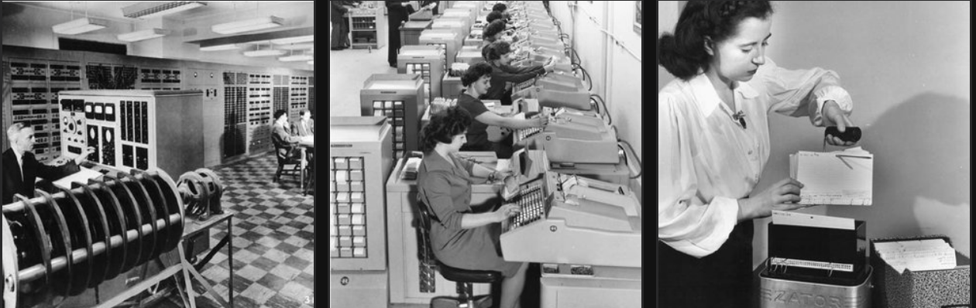
Motivations
Engineering and science problems are written in terms of mathematical equations
Numerical simulation is crucial to solve them (chemistry, economy, finance, mechanics, physics, natural science, biology ...)
Getting an explicit solution is not possible in real-life problems
We calculate an approximation on a computer, obtained from a system with a finite number of degrees of freedom/unknowns (a number, a vector, or a matrix)
Scientific Computing is fueling the 3rd and 4rd industrial revolutions
https://www.linkedin.com/pulse/crm-fourth-industrial-revolution-clint-oram/
Credits: Understanding How Computing Has_Changed the World’ T. Misa

Slide 6
Motivations
Numerical analysis is multidisciplinary:
design of methods for continuous mathematics (numerical analysts)
study of algorithms (computer scientists)
computer implementation and testing (software developers)

Slide 7
0.2 Examples

Slide 8
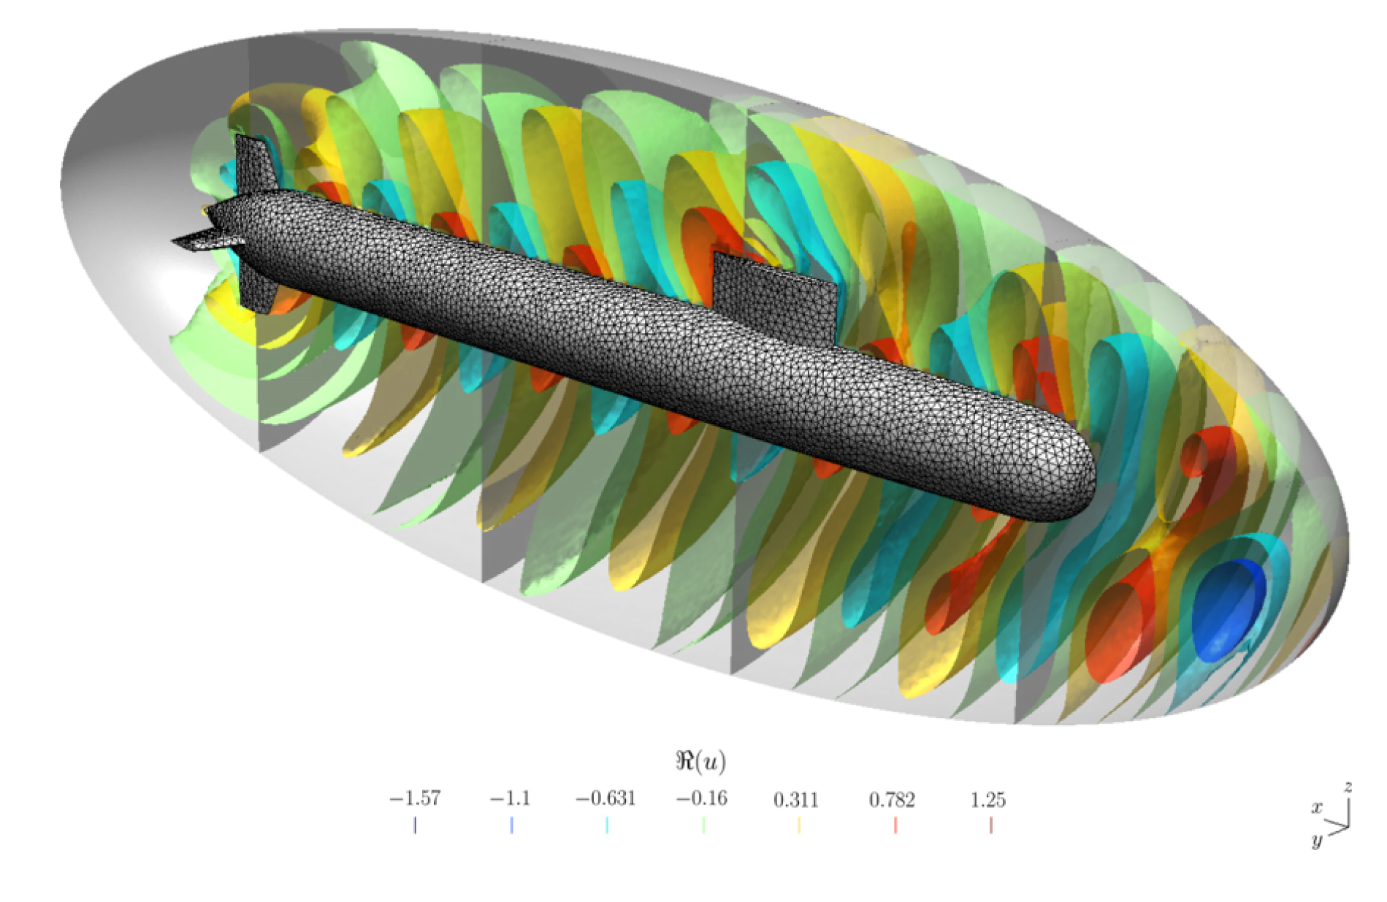
Example plane wave scattered by a submarine
Credits: gmsh fem

Slide 9
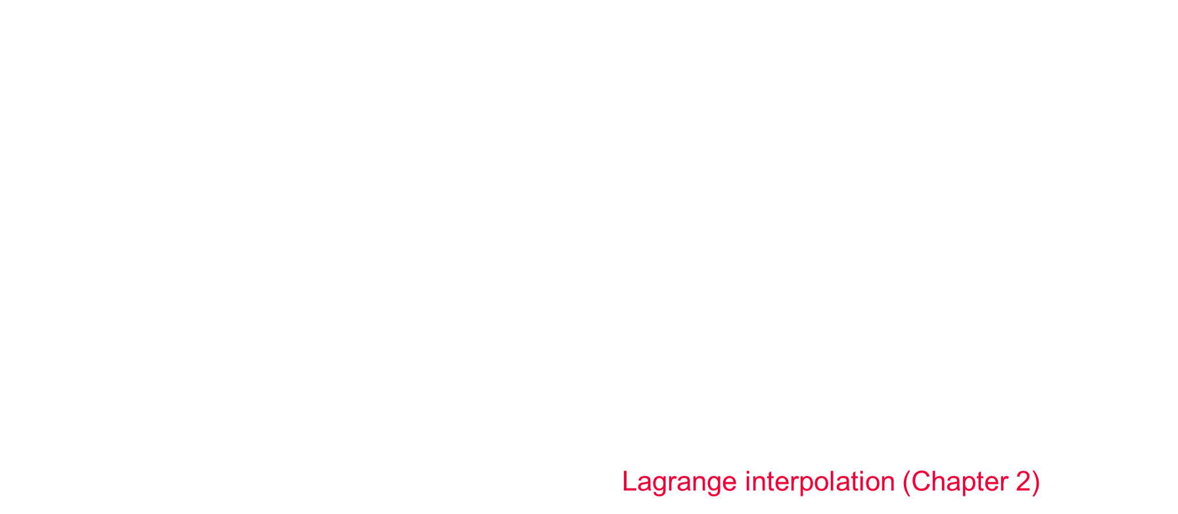
Weak formulation (Numerical solution of PDEs)
What tools do we need to solve such a problem?
First, a discrete representation of the geometry, here we have a 3D mesh (tetrahedrons),
In practice, it is easier to solve a weak/variational formulation (finite elements)
$$∫∇u ⋅∇v − k^{2}uv dΩ+ boundary terms = 0$$
$u$: unknown (here the pressure perturbation)
$v$: test-functions
We solve the problem for example at the nodes/vertices of the mesh to obtain a vector $u$.
Between the nodes the solution is interpolated: Lagrange interpolation (Chapter 2)

Slide 10
Weak formulation (Numerical solution of PDEs)
Solving the system
Integrate accurately polynomials over elements (triangles, tetrahedrons): quadrature (Chapter 3)
In addition, computing the gradient needs numerical differentiation (Chapter 3)
The operator being linear, we need to solve a linear system: numerical linear algebra (Chapter 5)
Related problems
Time-domain problem → dynamical system: resolution of ODEs (Chapter 4)
Nonlinear wavenumber dependency: k = k(u): solve nonlinear systems (Chapter 6)
A related problem concerns the eigenmodes of a vibrating structure: computation of eigenvalues & eigenfunctions (chapter 5)

Slide 11
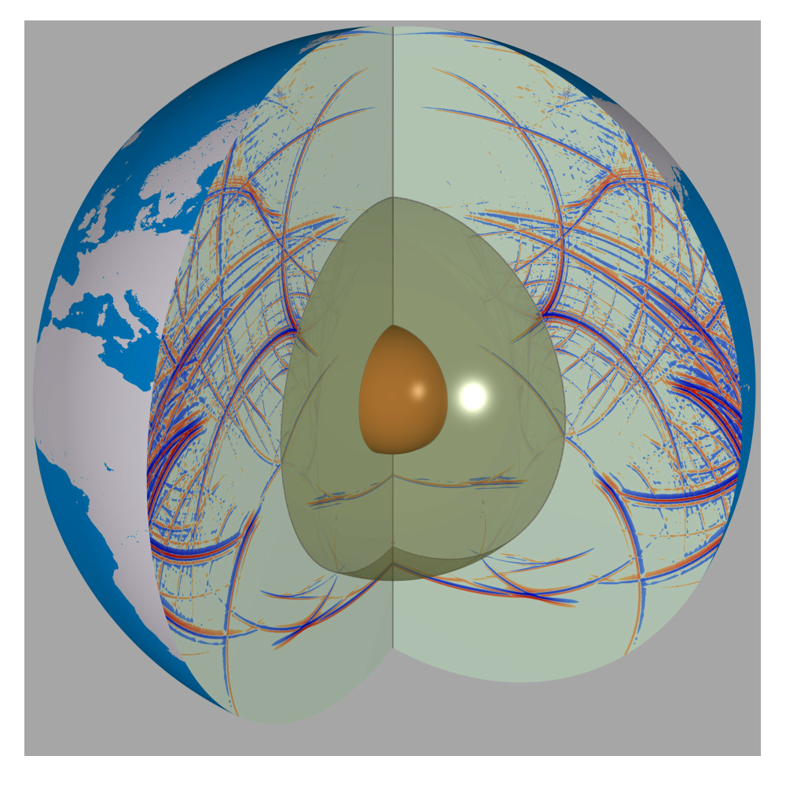
Geophysics: discover the earth interior structure
Sometimes we need to solve many problems for optimization purpose
→ minimize the error between measurements and simulations
From LMU Geophysics - Munich

Slide 12
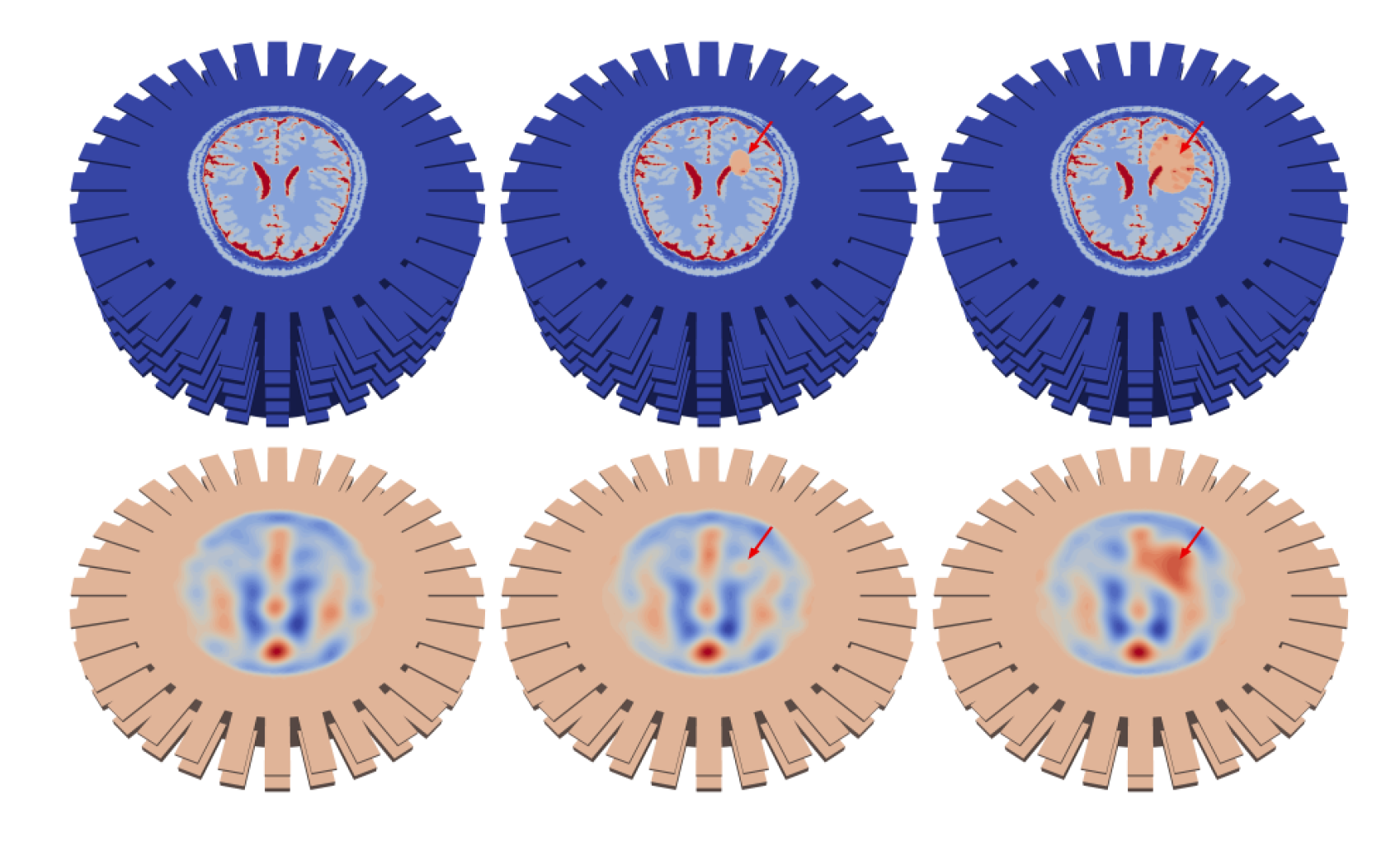
Medicine: preventing cerebrovascular accidents
Cheap and rapid detection of brain defects
(2015 Bull-Joseph Fourier Prize)

Slide 13
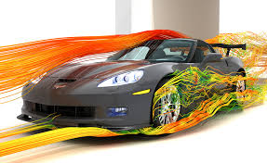
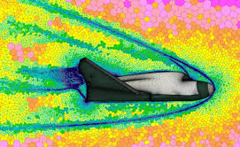
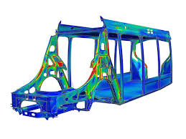
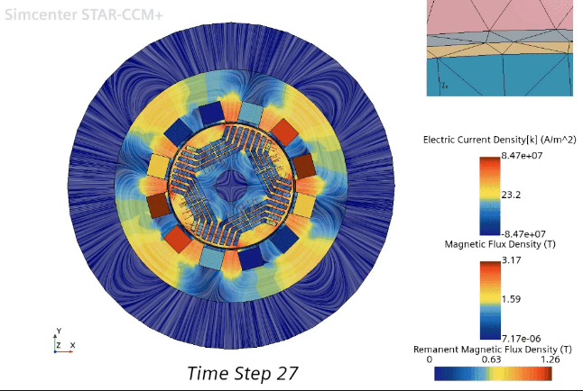
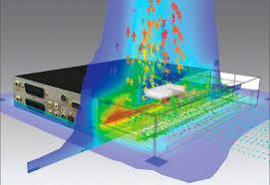
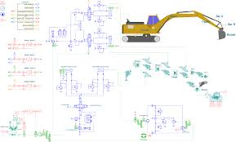
Last but not least
Electronics, Flow & thermal, Mechanical, Electro-mag, Space physics, Biology, Finance, etc.

Slide 14
0.3 Goal of the course & working plan

Slide 15
Motivations
Main goals:
To provide theoretical and practical elements related to numerical methods
Understanding how to go from the continuous to the discrete level (error estimates, algorithms, stability)
To be able to implement some methods (using Python)
Organization
1st half of the session: lecture, 2nd half: application/coding exercises with notebooks
The exercises are here to help you understand the theoretical notions
Grading: 50% assessment exercises + 50% group project
Good investment ⇒ success

Slide 16
0.4 Plan of the lectures

Slide 17
Plan of the lectures
Python/notebook reminder, notion of error in numerical analysis
Interpolation - Approximation
Derivation - Integration (+ choose a project)
Numerical solution of ODEs
Linear systems
Nonlinear systems of equations
Project presentations

